Slide 1
Hire a Pro/team at half cost or Free?
Get job done with top reach labs/Corporate Partners
Use expensive equipments for free
Global presence
Marketing channel to other Countries
Get paid
is that
?

Slide 2
Outreach Program
A valuable resource for local business owners

Slide 3
Who are we
HITxy
.org.au
Non-profit
Top Students
New to AU
Working locally

Slide 4
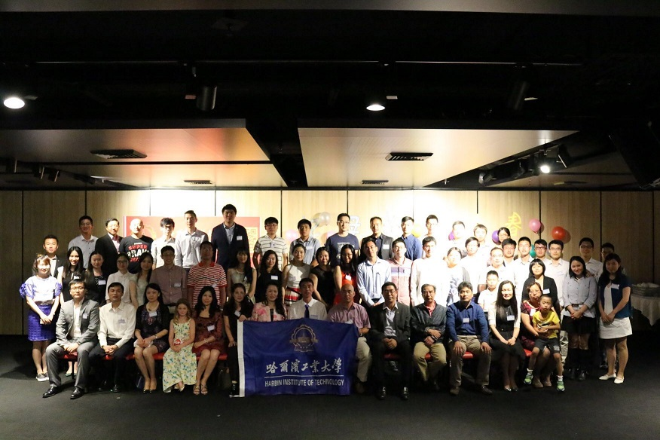
Where do members work
Sydney/Mel/Bri/Perth..
Top Uni – Research Labs
Visiting Prof/Scholar
Local Companies (graduated)
MNCorporate (graduated)

Slide 5
What do members want
Share!
Local experience
Culture blending
Challenge
Problem solving
Business/Social Insights
Internationalization

Slide 6
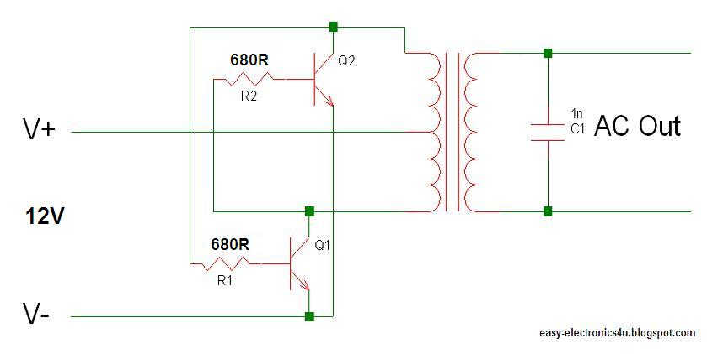
Concrete Example

Slide 7
Happy Business
Happy Customers
Proud Individuals
Engineering improvements

Slide 8
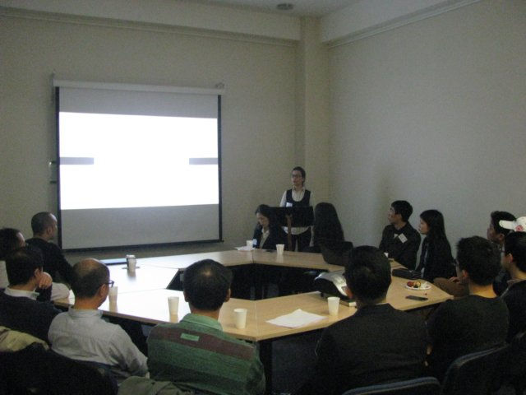
Outreach in action

Slide 9
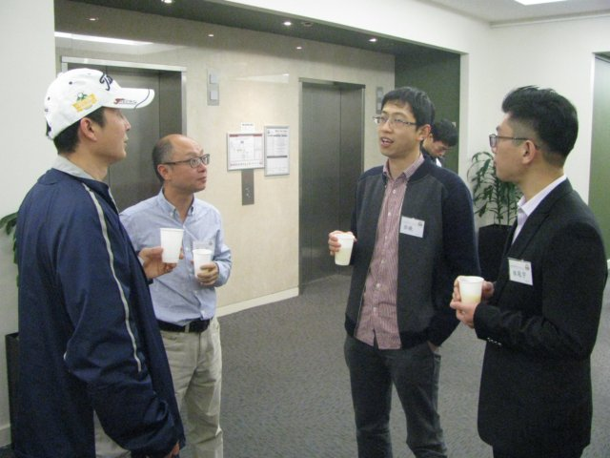
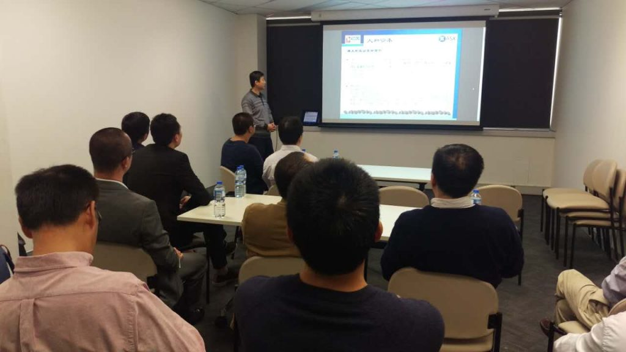
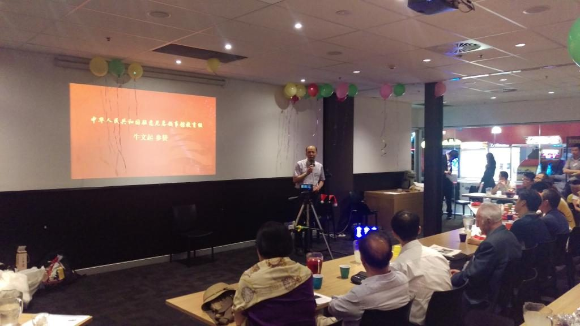

Slide 10
Highlights
Publicity
webcasting
Video record – long lasting
New members
Overseas media
Presence, Internationally
Conf
Resume
Presentations
Valuable feedbacks to speakers
Networking
Local
Foreign
Knowing other speakers
Potential employees or collaborators.
Speakers get paid
Many more…

Slide 11
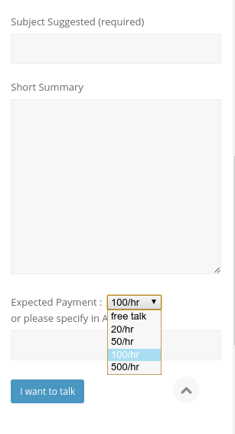
How to start?
http://www.hitxy.org.au/outreach

Slide 13
Hire a Pro/team at half cost or Free?
Get job done with top reach labs/Corporate Partners
Use expensive equipments for free
Global presence
Marketing channel to other Countries
Get paid
Wonderful

